Slide 1
Aiub football field

Slide 2
Name id 1.mahmudul hasan sAron 17-33808-1
GROUP MEMBERS

Slide 3
1.DESINGN OF THE FIELD 2.user interaction
INDEX

Slide 4
FEATURES
1.CONSTRUCTED THR FOOTBALL FIELD
2.ADD ALL ELEMENT THAT A FOOTBALL FIELD HAS
3.PIXEL RASTERIZATION
4.ADDED USER INTERACTION
5.GRAPHICAL USER INTERFACE
6.VISUALIZATION
7.VERTEX REPRESENTATION

Slide 5
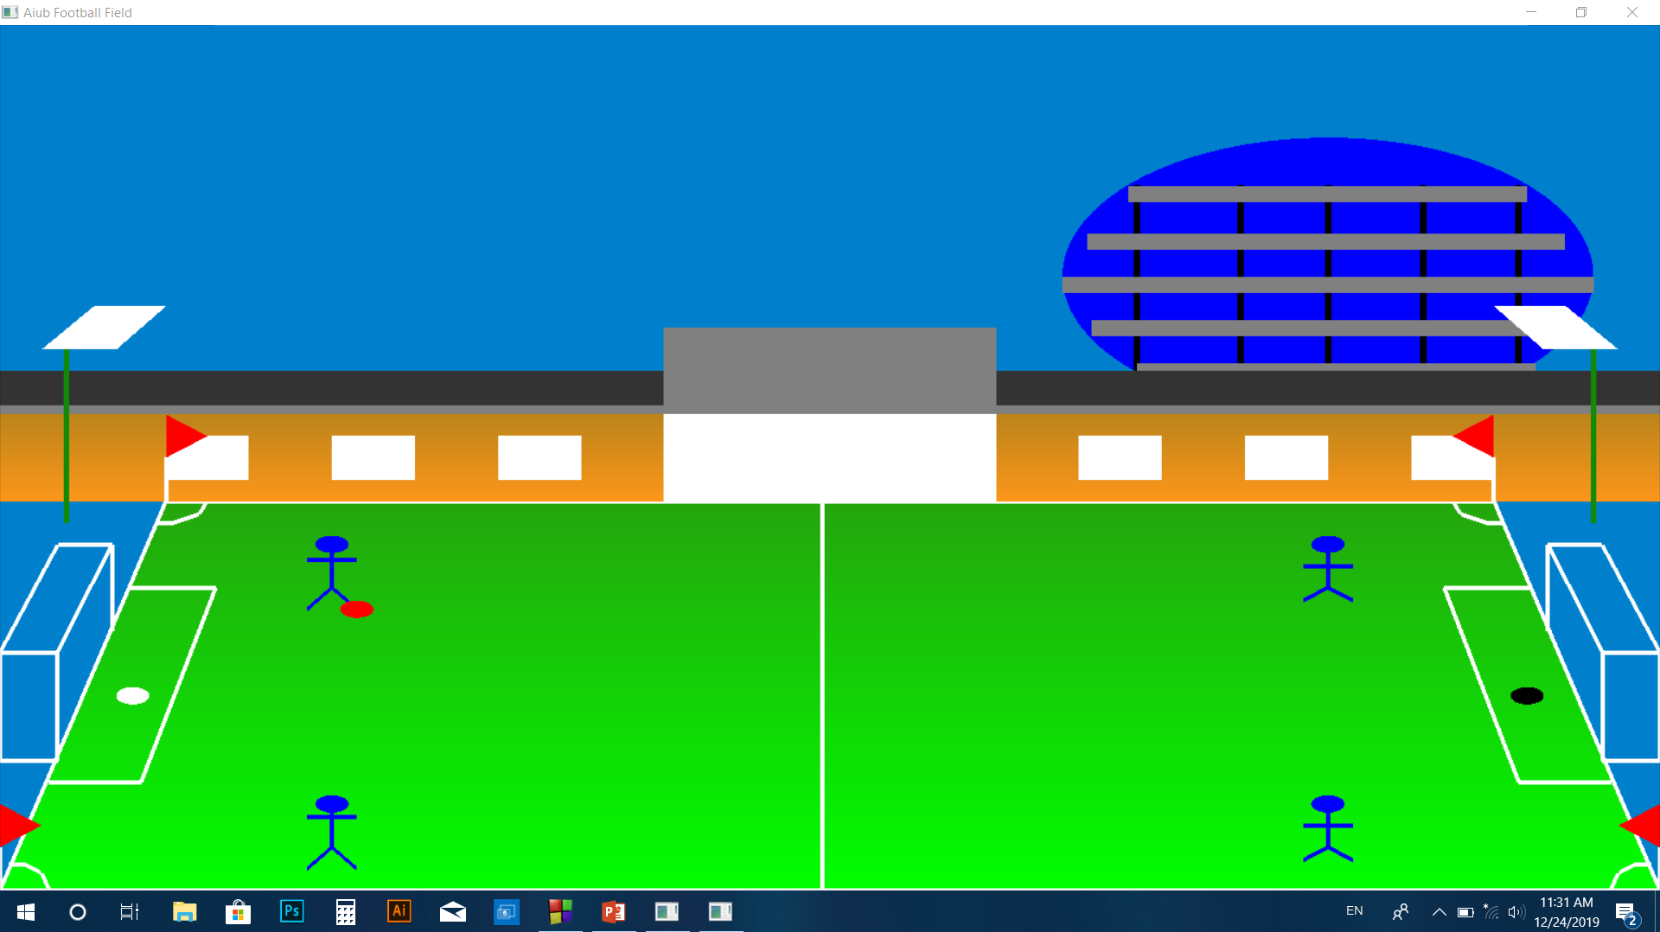
DAY MODE

Slide 6
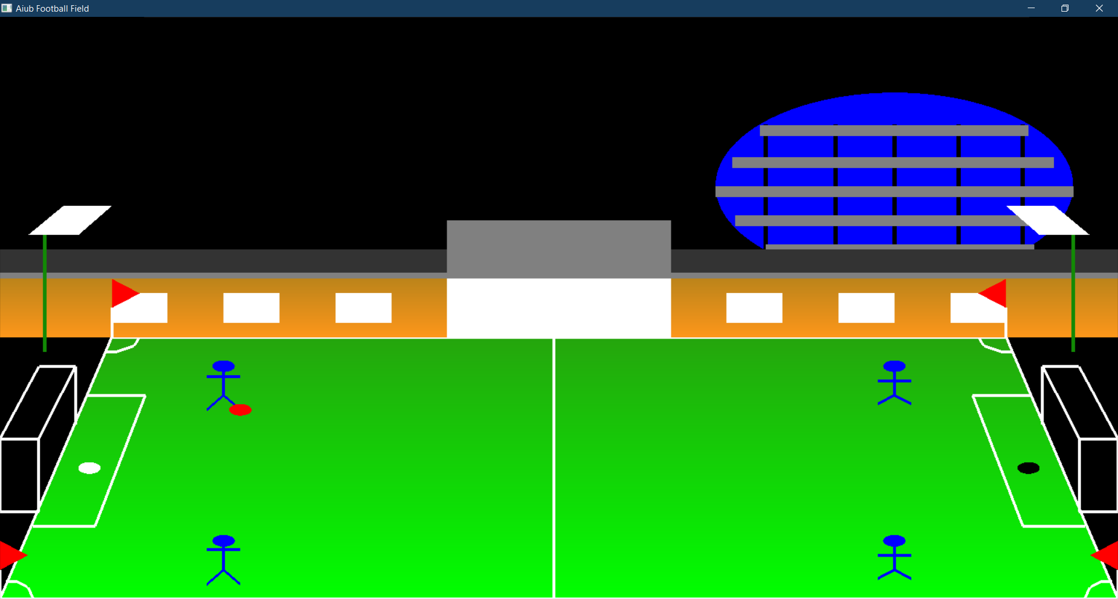
NIGHT MODE

Slide 7

P----→R.Pass
W----→L.Pass
L---→left bar goal
R---→Right bar goal
F----→ forward pass
B---→ back pass
N---→night mode

Slide 8


Slide 9
THANK YOU

